Slide 1



Shanghai Foreign Investment Association Vol. 3, 2022
上海市外商投资协会月度工作简报
2022年 第3期
MONTHLY REPORT

Slide 2
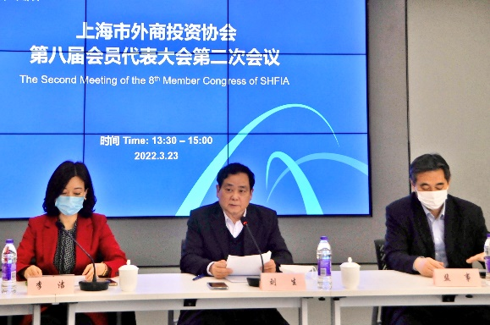
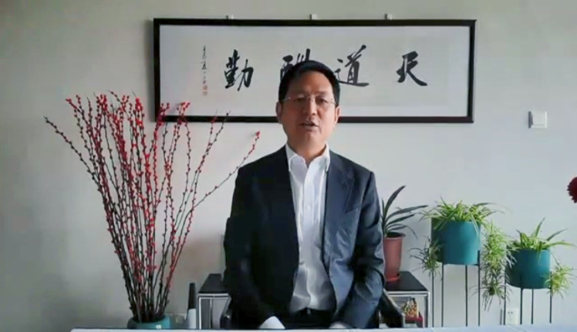
本月聚焦
协会第八届会员代表大会第二次会议暨第八届理事会第五次会议顺利召开
3月23日，协会第八届会员代表大会第二次会议暨第八届理事会第五次会议以视频会议方式召开，455名会员出席了会员代表大会，206名理事出席了理事会。协会副会长兼秘书长刘生、常务副秘书长李洁、尼康映像仪器销售（中国）有限公司副总经理兼工会主席张新监事在协会主会场出席会议。黄峰会长视频致辞，会议由副会长兼秘书长刘生主持。
刘生副会长兼秘书长作协会2021年工作总结和2022年工作计划报告、2019-2020年理事会工作报告，张新监事作2019-2021年监事会工作报告。会员代表大会听取了《协会2021年工作报告和2022年工作计划》和《协会2021年财务决算和2022年财务预算》，审议并通过了《2019-2020年理事会工作报告》、《2019-2021年监事会工作报告》、《关于协会变更住所的议案》、《协会理事和副会长选举办法》；确认了第八届理事会第三次会议和第八届理事会第四次会议选举的69名理事的理事资格，并选举了28名新理事。
理事会审议通过了《关于协会2021年工作报告和2022年工作计划的议案》、《关于协会2021年财务决算、财产清册和2022年财务预算的议案》、《关于聘任协会副秘书长的议案》、《关于会员变动情况的议案》、《关于设立新分支机构的议案》、《关于开展关爱云南怒江青少年发展公益和志愿服务项目的议案》、《关于设立上海发展研究基金会外资发展专项基金的议案》、《关于增加协会员工福利的议案》。会议同意聘任麻伟锋先生和马蓝女士担任协会副秘书长，新设人力资源分会，选举米其林高级副总裁王兆华、福特汽车政府事务副总裁向小芳、康宝莱对外事务部副总裁董瑞萍等10位理事为副会长。此次会议由上海市张江公证处公证。（图1）
协会外企志愿服务联盟组织会员企业向防疫志愿者捐赠物资
协会外企志愿服务联盟（上海外企志愿服务总队）响应上海市志愿者协会、上海市志愿服务公益基金会的号召，组织会员企业向奋战在抗疫一线的志愿者捐赠防护类、食品饮品类物资。杜邦、安利、液化空气、百事、康师傅、3M、恒天然、达能、三得利、霍尼韦尔、佛吉亚、三井住友海上火灾保险、滴露等13家企业积极响应，捐赠了防护服、口罩、消毒液、方便面、牛奶、饮料等产品。
杜邦中国捐赠了600件防护服；霍尼韦尔捐赠了500000只KN95口罩、10000副护目镜、1500盒一次性手套和10000瓶皮肤抑菌喷雾；液化空气中国捐赠了200000只一次性医用外科口罩、20000只KN95防护口罩、800瓶免洗手消毒凝胶、800瓶84消毒液和500个医用隔离面罩；3M捐赠了20000只N95防护口罩和2000瓶免洗手消毒液；安利捐赠了366瓶净手免洗凝露、1000个便携瓶、500盒蛋白粉；曼伦商贸捐赠了7504瓶滴露消毒液、12000瓶泡沫洗手液和11160瓶消毒喷雾。佛吉亚捐赠了30000套防护服驰援吉林长春。这些防疫物资为坚守在一线的防疫志愿者们筑起了更安全的防护屏障。
图1
图1

Slide 3
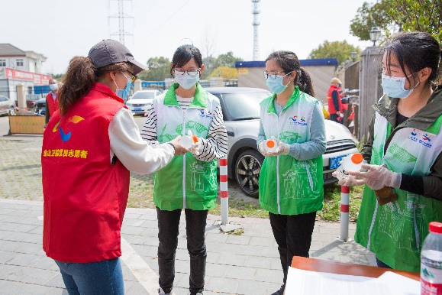
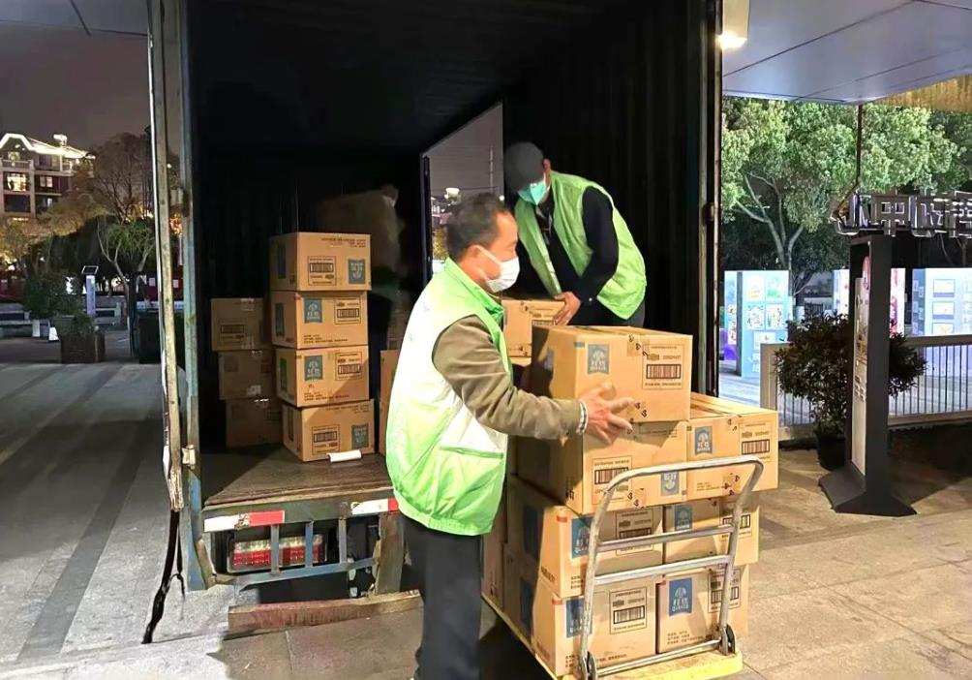
恒天然捐赠了500箱安佳全脂纯牛奶；康师傅捐赠了500箱方便面；百事捐赠了6000瓶佳得乐运动饮料、3600袋桂格即食燕麦和1314箱合计25470份包括桂格燕麦、乐事薯片、奇多、百草味等营养和休闲食品；达能捐赠了186000瓶脉动维生素饮料和1200罐幼儿配方奶粉；三得利捐赠了2500箱维体（维生素）；三井住友海上火灾保险采购了大米、食用油、速冻水饺、牛奶、麦片等近5万元的食品。这些物资帮助防疫志愿者们补充营养、解决了就餐问题。
感谢会员企业的爱心捐赠！这是协会外企志愿服务联盟成立以来首次组织的大规模会员捐赠活动，我们将会同我们的合作伙伴上海市志愿服务公益基金会一起，支持会员企业履行社会责任。（图2）
图2
图2
协会动态
3月3日
协会副秘书长麻伟锋参加第46届世界技能大赛赞助商交流会并发言。（图3）
3月4日
协会会长黄峰接待了长宁区商务委主任骆乐一行，双方就未来合作进行了交流。
3月4日
协会常务副秘书长李洁考察复旦大学消费市场大数据实验室，并与实验室主任张伊娜教授作交流。（图4）
3月8日
市人社局和上海企联召开涉企劳动关系政策咨询座谈会，听取部分社会团体关于本市2022年最低工资标准和促进就业立法方面的意见和建议。协会会长黄峰出席会议并作交流发言。
3月9日
协会会长黄峰拜访上海市志愿服务公益基金会，理事长蔡伟民接待，双方就关爱云南怒江青少年发展公益和志愿服务项目相关事宜进行了交流。
3月10日
协会党支部书记刘生参加市商务委党风廉政建设工作会议。商务委党组书记、主任顾军作重要讲话。

Slide 4
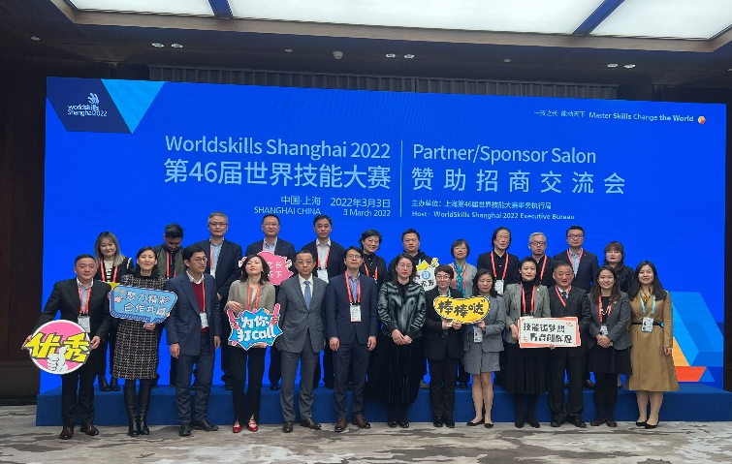
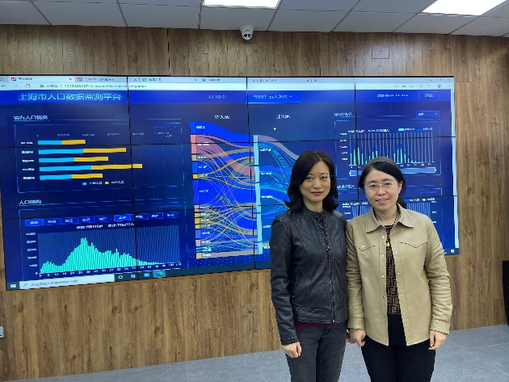
图3
图4
3月25日
欧莱雅中国在上海举办“25周年发展战略年度线上沟通会”。协会会长黄峰参会。
协会活动
3月协会共举办9场活动。1-3月累计举办活动24场，完成全年举办130场活动目标的18%。
3月3日
协会举办2022年外商投资信息报告年度报告培训。本次培训以线上直播、线下讲座相结合的形式进行，邀请市市场监督管理局信用处、市市场监督管理局登记注册处、市商务委外国投资管理处老师介绍了2021年度年报的主要变化；对《市场主体登记管理条例》出台相应事项的变化等新政做了解读；介绍了外商投资企业信息报告制度的合规要求、企业应当承担的法律责任以及企业信息公示与更正的方式。
3月24日
协会联合上海蓝白律师事务所举办“疫情隔离期的企业劳动用工热点问题” 政策讲座，由上海蓝白律师事务所合伙人进行线上主讲并在线答疑。此次讲座吸引了来自外资企业的326人参加。讲座中，律师从隔离类型、工作安排、休假安排、工资支付、企业纾困、劳动关系等6个方面阐述了企业在员工隔离办公期间所需注意的要点。特别是在工资支付方面，律师对企业如何支付员工工资、能否取消津贴福利、能否取消绩效奖金等具体事项做了说明。
3月25日
协会举办“赋能中小企业系列讲座：税收筹划中的风险控制” 线上讲座，邀请力传（上海）财务管理咨询有限公司为协会中小会员企业介绍了税收征管工作的核心思路，分析了税收筹划的特性和原则，解读了近期税收政策，进行了相关案例解析，并回答了企业提出的问题。90名会员企业以及其他中小企业的代表参加了本次活动。本次讲座也是协会赋能中小企业系列讲座的首场活动。
3月31日
协会举办“2022上海国际碳中和技术、产品与成果博览会” 线上推介会，60余家来自能源、化工、汽车、工程、医药、消费品和餐饮等行业的会员企业代表参会。协会副秘书长麻伟

Slide 5
锋致欢迎辞。市贸促会顾春霆副会长介绍了“碳中和博览会”的相关背景，市贸促会国展公司王蕾总裁具体介绍了展会筹备和进展情况。
3月活动列表：
活动类型 | 时间 | 主题
年度活动 | 3月23日 | 上海市外商投资协会第八届会员代表大会第二次会议暨第八届理事会第五次会议
政企沟通 | 3月31日 | 数据跨境流动相关政策建议讨论座谈
MPI | 3月3日 | 乌克兰危机与大国关系
政策讲座 | 3月3日 | 2022年外商投资信息报告年度报告
 | 3月24日 | 疫情隔离期的企业劳动用工热点问题
 | 3月25日 | 赋能中小企业系列讲座：税收筹划中的风险控制
技能培训 | 3月22日 | 中国社交媒体营销终极指南2022
分会活动 | 3月4日 | 医药健康分会 — 国家药品监督管理局药品审评检查长三角分中心与企业面对面
其他活动 | 3月31日 | 2022上海国际碳中和技术、产品与成果博览会（碳中和博览会）推介会
会员交流
因疫情原因，3月协会走访了15家会员企业。1-3月累计走访会员企业71家，完成年度走访600家会员目标的 11.8%。
3月1日，会长黄峰走访东瑞盛世利融资租赁有限公司，与董事/总经理森田泰则进行交流会谈。
3月1日，副会长兼秘书长刘生一行走访了上海鑫美野营用品有限公司，总经理凌志伟先生接待。
3月1日，西门子（中国）有限公司政府事务总监郑舟、政府事务经理何思彤来访协会，常务副秘书长李洁和副秘书长朱菁接待并交流。
3月2日，安博（中国）管理有限公司副总裁廖伟翔一行来访协会。副会长兼秘书长刘生接待并进行交流。
3月3日，会长黄峰走访仲利国际租赁有限公司，与总经理陈坤明进行交流。

Slide 6
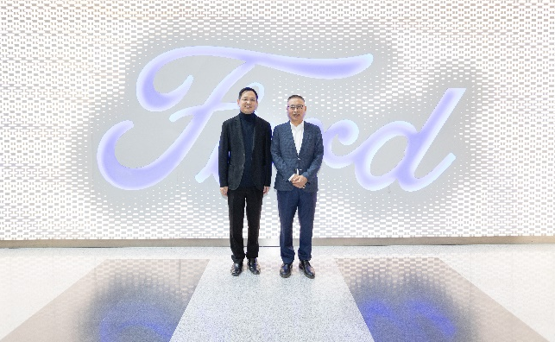
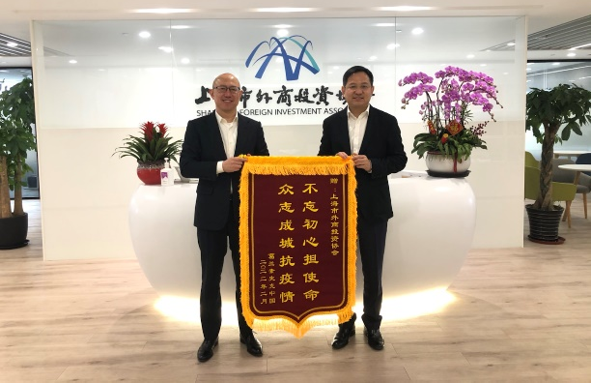
3月3日，会长黄峰走访福特中国设计中心，与福特汽车(中国)有限公司总裁兼首席执行官陈安宁进行交流。（图5）
3月3日，副秘书长麻伟锋走访上海化学工业区发展有限公司，与经营部高级项目经理李铭和办公室高级主管陈晓中进行交流。
3月4日，葛兰素史克（中国）投资有限公司副总裁马征先生一行到访协会并赠送锦旗，感谢协会为会员提供帮助，为企业纾困提供援手。（图6）
3月8日，副秘书长朱菁走访上海吉田拉链有限公司，与姚燕女士进行交流。
3月9日，副秘书长麻伟锋走访福斯润滑油企业管理（上海）有限公司，和行政总监杜惠华进行交流。
3月10日，会长黄峰走访大金（中国）投资有限公司，与人事部部长王宾、营业大项目部部长徐沙林、技术部部长冯冠文作了交流。
图5
图6
走访企业名单（15家）：
上海尤希路化学工业有限公司
百佑佳食品贸易（上海）有限公司
东瑞盛世利融资租赁有限公司
上海鑫美野营用品有限公司
艾默生电气（中国）投资有限公司
上海化学工业区发展有限公司
大金（中国）投资有限公司
欧莱雅（中国）有限公司
福特汽车（中国）有限公司
仲利国际租赁有限公司
霍尼韦尔（中国）有限公司
路易达孚（上海）有限公司
上海吉田拉链有限公司
福斯润滑油企业管理（上海）有限公司
上海特雷通智能家居有限公司
新会员
3月新入会企业6家，本年度累计新入会企业14家，完成全年发展新会员100家目标的14%。

Slide 7
利惠商业（上海）有限公司
Levi Strauss公司是世界上知名的品牌服饰公司之一，成立于1853年，也是牛仔服装的全球领先企业。公司设计与销售男士、女士和儿童牛仔装、休闲服饰及相关配件，拥有Levi’s® 、Dockers® 、Signature by Levi Strauss & Co.™ ，以及Denizen® 品牌。通过连锁零售商、百货公司、电商以及全球3000多家加盟商与公司运营店，公司产品远销全球110多个国家。2020年，Levi Strauss公司财年净收入为45亿美元. 公司连续2年荣登《财富》“全球最受赞赏企业” 排行榜，2021年位居服饰行业第3位。
利惠商业（上海）有限公司是Levi Strauss公司在上海市成立的全资子公司，另在广州、北京、成都设有分公司。Levi’s®品牌从2002年起开始在中国宣传、推广、销售。Levi’s® 代表了经典的美式风格和率性自由的文化，目前已经成为中国消费者所熟知的牛仔品牌。
捷温科技（上海）有限公司
捷温集团是全球创新型汽车热管理技术设计、开发和制造领域的行业领导者。汽车产品包括气候控制座椅、加热汽车内饰系统、电池性能和热管理系统、线束产品及汽车电子产品并提供产品的相关服务。近些年，捷温加大研究投入，推出个性化汽车智能微气候系统等，电池电芯智能链接系统，不断扩充产品线并逐步扩大生产规模。
捷温科技（上海）有限公司作为亚太及中国区域总部，公司坐落上海张江高新科技园区。总投资300万美元,注册资金200万美元，公司占地面积3997平方米。作为捷温集团亚太区总部，捷温科技（上海）有限公司自身集销售客服、项目管理、设计研发、质量及供应链、全球采购、汽车技术研发应用、风机研发及应用、电子测试中心与行政部门职能为一体。下属的6家分公司其中包含3家生产型企业，足迹遍布中国上海、深圳、廊坊、香港，日本东京、名古屋、横滨、韩国牙山、蔚山、越南河南。
融物宝国际融资租赁有限公司
融物宝国际融资租赁有限公司成立于2014年11 月，公司注册资本17500万元人民币。业务以江浙沪为核心辐射全国，涉及行业涵盖集成电路和半导体、高端制造、新能源、新材料、电力电子、市政基础设施等领域。融物宝企业平台也是与所属母公司集团股权投资平台业务并行共进、相辅相成的，股权投资业务主要关注于新能源、泛半导体等智能制造行业，积极参与到先进制造产业发展中，此外也密切关注全球价值标的的海外并购和扩产机会，整合产业资源，实现产业发展和价值投资的有效结合。
伍德佳帕塔设计咨询（上海）有限公司
伍德佳帕塔设计咨询（上海）有限公司成立于 2002年，由 Benjamin Wood 先生创立。公司自成立以来，始终秉承“以人为本”的设计理念，凭借独到的建筑商业运营眼光，努力为受众及业主打造集建筑与商业融为一体的典范，公司设计的项目不仅具有极强的落地性，同时也是商业运营成功的典范。在设计上，我司努力探求建筑形式与功能之间的新联系，力求向世人展现一种全新的空间感受。
上海贤思律师事务所
上海贤思律师事务所是由具备深厚法律功底、良好社会资源、丰富实践经验的律师创设的涉外法律服务机构，致力于在公司与商事、跨境投资、商事纠纷解决领域，借助全球资源、本地智慧，为国内外中小企业商务活动识别并管控法律风险，实现法律规范与商业利益的平衡。
在诉讼领域，贤思商务律师代理了近千起不同涉案金额的国内、涉外商事诉讼、仲裁案件（其中许多案例被“北大法宝”等裁判文书数据库收录为“经典案例”或者“推荐案例”）。在非诉讼领域，贤思商务律师以扎实的专业知识和高度的敬业精神，成功为多家外商投资企业承办过多起直接投资项目、资产收购项目、股权收购项目、跨境资产重组项目，累计完成交易金额数十亿元。后期，贤思商务律师团队在私募股权投资、债券发行及区域股权交易市场挂牌法律服务领域为多起项目提供过法律服务；不仅如此，作为理事之一，贤思还依

Slide 8
托与中南财经政法大学股权投资校友会的平台资源，为多家具有成长潜力的企业促成了数亿元上市前的多轮股权融资。
上海博锋金属制品有限公司
上海博锋金属制品有限公司成立于2003年，位于中国上海，是一家专业从事工具和户外产品的研发、生产和销售为一体的跨国公司。上海博锋拥有强大的产品研发团队，能敏锐察觉全球市场的需要，将产品进行功能化创新及逻辑优化组合，不断研发出新颖时尚的畅销产品。公司拥有设备齐全的多功能实验室，通过建立完整的检测标准及流程，对原材料化学成份及有害物质等进行检测分析, 对产品进行相应检验，确保货物品质。
菲仕兰食品贸易（上海）有限公司
荷兰皇家菲仕兰公司创建于1871年，迄今已有151年的历史，2004年被荷兰女王授予“皇家”称号，在32个国家设有分支机构，拥有2万多名雇员；在欧洲有超过一万多个自家牧场和近一万六千名会员奶农，销售遍及全球100多个国家。公司总部位于荷兰阿默斯福特，设有四个全球业务集团：食品饮料业务集团、专业营养品业务集团、配料业务集团和大宗乳制品业务集团。
在中国，荷兰皇家菲仕兰旗下的荷兰全进口婴幼儿配方奶粉品牌“美素佳儿”广受消费者的青；菲仕兰还在餐饮渠道经营和销售黑白淡奶、黑白纯牛奶、奶酪、黄油等产品，并向中国食品和婴幼儿配方奶粉生产商销售乳品原料。本土生产的Dutch Lady子母品牌婴幼儿配方奶粉自2016年上市以来，已在华东华南华西等省的下线城市取得了稳步发展。2013年11月，荷兰皇家菲仕兰、荷兰瓦赫宁根大学和中国农业大学共同成立了中荷奶业发展中心，从整个乳品产业链提升中国乳品生产、安全和质量水平。
麦肯锡（上海）咨询有限公司
麦肯锡是一家全球性管理咨询公司，致力于帮助各类组织实现有价值的变革。公司咨询顾问遍布逾 67 个国家、133 个城市。中国，在北京、上海、深圳、香港、台北和成都开设了六家分公司，拥有超过一千名全球合伙人、咨询师和业务支持专家。麦肯锡为各个地区的领军企业、政府和机构提供咨询服务，并深受客户的信任。公司使命是帮助客户解决其在战略、销售与市场、运营、组织、技术和公司金融等各方面的难题，进而获得显著而持久的成效。

Slide 9
HIGHLIGHTS
2nd meeting of 8th Member Congress and 5th session of 8th Council of SHFIA successfully convened
On Mar. 23, the 2nd meeting of the 8th Member Congress and the 5th session of 8th Council of SHFIA was officially held by video conference. 455 members attended the member congress and 206 board directors attended the board meeting. Liu Sheng, SHFIA Vice Chairman and Secretary-General, Jessica Li, SHFIA Executive Deputy Secretary-General, and Zhang Xin, SHFIA Supervisory Board Member and Vice GM &Labor Union Chairman of Nikon Imaging (China) Sales Co., Ltd. attended the meeting at the association’s main site. With Chairman Huang Feng delivering a video speech, the meeting was chaired by Liu Sheng.
At the meeting, Liu Sheng delivered SHFIA’s 2021 work report and 2022 work plan as well as 2019-2020 board report, while Zhang Xin delivered the 2019-2021 supervisory board report. The member congress listened to the SHFIA 2021 Work Report and 2022 Work Plan and the SHFIA 2021 Financial Report and 2022 Financial Budget; reviewed and approved the 2019-2020 Board Report, 2019-2021 Supervisory Board Report, Proposal on SHFIA’s Change of Business Address, and Measures for SHFIA’s Election of Board Directors and Vice Chairpersons; and confirmed the election of 69 board directors at the 3rd and 4th meeting of the 8th SFIA Board of Directors. 28 new board directors were also elected at the meeting.
The Council reviewed and approved the Proposal on SHFIA 2021 Work Report and 2022 Work Plan, Proposal on SHFIA 2021 Financial Report & Asset Inventory and 2022 Financial Budget, Proposal on the Appointment of SHFIA Deputy Secretary-Generals, Proposal on Membership Changes, Proposal on Establishing New Branch, Proposal on Launching Public Welfare and Volunteer Service Project to Care for Youth Development in Nujiang, Yunnan, Proposal on Establishing a Special Fund for Foreign Investment Development at the Shanghai Development Research Foundation, and Proposal on Improving the Benefits of SHFIA Staff. The board meeting agreed to appoint Wilson Ma and Ma Lan as SHFIA’s deputy secretary-generals, set up a new human resources branch, and elect 10 new SHFIA vice chairpersons, including Wang Zhaohua, SVP of Michelin China, Xiang Xiaofang, VP Government Affairs of Ford China, and Dong Ruiping, VP Corporate Affairs of Herbalife Nutrition. The meeting was notarized by the Zhangjiang Notary Public Office. (Image 1)
SHFIA’s FIE Volunteer Alliance organizes member enterprises to donate supplies to anti-COVID volunteers
Echoing the call of the Shanghai Volunteer Association and the Shanghai Public Service Foundation for Volunteers, SHFIA’s FIE Volunteer Alliance (Shanghai FIE Volunteer General Team) organized member enterprises to donate protective and F&B supplies to
Image 1
Image 1

Slide 10
volunteers fighting on the anti-COVID frontline. 13 enterprise including DuPont, Amway, Air Liquide, Pepsi, Master Kong, 3M, Fonterra, Danone, Suntory, Honeywell, Faurecia, Mitsui Sumitomo Insurance, and Dettol actively responded and donated supplies including protective suits and masks, disinfectants, instant noodles, milk, and beverages.
DuPont China donated 600 protective suits; Honeywell donated 500,000 KN95 protective masks, 10,000 pairs of protective goggles, 1,500 boxes of disposable gloves, and 10,000 bottles of antibacterial skin spray; Air Liquide China donated 200,000 disposable medical surgical masks, 20,000 KN95 protective masks, 800 bottles of wash-free hand sanitizer gel, 800 bottles of 84 disinfectant, and 500 medical face shields; 3M donated 20,000 N95 protective masks and 2,000 bottles of wash-free hand sanitizer; Amway donated 366 bottles of wash-free hand sanitizer gel, 1,000 portable bottles, and 500 boxes of protein powder; and RB & Manon Business donated 7,504 bottles of Dettol disinfectant, 12,000 bottles of foam hand sanitizer, and 11,160 bottles of disinfectant spray. Faurecia donated 30,000 protective suits to Changchun, Jilin Province. These anti-COVID supplies help provide stronger protection for anti-COVID volunteers fighting on the frontline.
Fonterra donated 500 cartons of Anchor full-cream pure milk; Master Kong donated 500 cartons of instant noodles; PepsiCo donated 6,000 bottles of Gatorade sports drink, 3,600 bags of Quaker instant oats, and 1,314 cartons (25,470 packs) of nutritious and snack foods including Quaker, Lay's, Cheetos, and Be & Cheery; Danone donated 186,000 bottles of Mizone vitamin drink, and 1,200 cans of infant milk formula; Suntory donated 2,500 cartons of Weiti vitamin drink; and Mitsui Sumitomo Insurance purchased food supplies worth nearly RMB 50,000, including rice and cooking oil, frozen dumplings, milk, and cereals. These supplies help anti-COVID volunteers supplement nutrition and solve dining needs.
SHFIA would like to thank member enterprises for their generous donations! This is the first large-scale member donation organized by SHFIA’s FIE Volunteer Alliance since its establishment. We will continue to work with the Shanghai Public Service Foundation for Volunteers to support member enterprises in fulfilling their social responsibilities. (Image 2)
Image 2
Image 2
SHFIA NEWS
Mar. 3
Wilson Ma, Deputy Secretary-General of SHFIA, attended and delivered a speech at the sponsor exchange meeting of the 46th WorldSkills. (Image 3)

Slide 11
Mar. 4
Huang Feng, Chairman of SHFIA, received Luo Le, Director of the Changning District Commerce Commission, and the two sides exchanged views on future cooperation.
Mar. 4
Jessica Li, Executive Deputy Secretary-General of SHFIA, visited the Consumer Market Big Data Laboratory of Fudan University, and communicated with Professor Zhang Yina, the director of the lab. (Image 4)
Mar. 8
The Shanghai Human Resources and Social Security Bureau and the Shanghai Enterprise Federation held a consultation symposium on enterprise-related labor policies to collect opinions and suggestions from local social groups on the city’s 2022 minimum wage standard and employment promotion legislation. Huang Feng, Chairman of SHFIA, attended and spoke at the symposium.
Mar. 9
Huang Feng, Chairman of SHFIA, visited the Shanghai Public Service Foundation for Volunteers, where he was received by the foundation’s board chairman Cai Weimin. The two sides exchanged views on matters related to the public welfare and volunteer service project to care for youth development in Nujiang, Yunnan Province.
Mar. 10
Liu Sheng, the party secretary of SHFIA, attended the work conference on party conduct and discipline at the Shanghai Municipal Commerce Commission. Gun Jun, the commission’s party secretary and director, delivered important remarks.
Mar. 25
L'Oreal China held the "25th Anniversary Development Strategy Annual Online Communication Session" in Shanghai, and SHFIA Chairman Huang Feng was invited to attend.
Iamge 3
Image 4
SHFIA EVENTS
In Mar., SHFIA held 9 events. From Jan. to Mar., the association held a total of 24 events, completing 18% of its 130-event annual target.

Slide 12
Mar. 3
SHFIA held the 2022 training on the annual reporting of foreign investment information. Combining online livestreaming and offline lecture, the event invited lecturers from the Shanghai Municipal Administration for Market Regulation’s department of enterprise credit and department of business registration and the Shanghai Municipal Commerce Commission’s department of foreign investment administration. The lecturers introduced the key changes from the 2021 annual reporting process; offered interpretation of new policies such as changes stipulated by the Regulation on Registration and Administration of Market Entities; and presented the compliance requirements of the information reporting system for foreign-invested enterprises, the legal responsibilities that enterprises should bear, and the methods for publicizing and correcting enterprise information.
Mar. 24
SHFIA teamed up with Shanghai Lanbai Law Firm to hold a policy lecture themed "Hot Issues in Enterprise Labor and Employment during the COVID-19 Isolation Period", inviting the law firm’s partners to deliver an online lecture and answer questions online. The lecture attracted 326 participants from foreign-invested enterprises. During the lecture, lawyers presented key issues that enterprises need to pay attention to when employees work in COVID-related isolation from six aspects, including isolation types, work arrangements, leave arrangements, salary payments, corporate aids, and labor relations. Especially regarding salary payments, lawyers explained specific matters such as how enterprises should pay the salary of their employees, whether allowances and benefits can be cancelled, and whether performance bonus can be cancelled.
Mar. 25
SHFIA held an online lecture themed "Empowering Small and Medium-Sized Enterprises (SME): Risk Control in Tax Planning", and invited Lichuan (Shanghai) Financial Management Consulting Co., Ltd. to introduce the core ideas of tax collection and management to SHFIA’s SME members. The company also analyzed the characteristics and principles of tax planning, interpreted recent tax policies, provided related case studies, and answered questions from member enterprises. Representatives of 90 member enterprises and other SMEs participated in the event. This lecture was also the first leg of SHFIA’s series of lectures on empowering SMEs.
Mar. 31
SHFIA held an online promotion meeting for the "2022 Shanghai International Carbon Neutrality Expo in Technologies, Products and Achievements", which was attended by representatives of more than 60 member enterprises from sectors including energy, chemical, automotive, engineering, pharmaceutical, consumer goods and catering. At the event, Wilson Ma, Deputy Secretary-General of SHFIA, delivered a welcome speech, Gu Chunting, Vice Chairman of the Shanghai Council for the Promotion of International Trade (SHCPIT), introduced the relevant background of the "Carbon Neutrality Expo", and Wang Lei, President of SHCPIT Exhibition Company, introduced the expo’s preparation and progress in detail.
List of SHFIA events in Mar.
Type | Date | Theme
Annual event | Mar. 23 | 2nd meeting of 8th SHFIA Member Congress and 5th meeting of 8th SHFIA Board of Directors

Slide 13
Type | Date | Theme
Gov.-business exchange | Mar. 31 | Discussion Panel on Policy Suggestions Related to Cross-Border Data Flow
MPI | Mar. 3 | The Ukraine Crisis and Great Power Relations
Policy lecture | Mar. 3 | 2022 Annual Reporting of Foreign Investment Information
 | Mar. 24 | Hot Issues in Enterprise Labor and Employment during the COVID-19 Isolation Period
 | Mar. 25 | Lectures to Empower SMEs: Risk Control in Tax Planning
Skill training | Mar. 22 | 2022 Ultimate Guide to Social Media Marketing in China
Branch event | Mar. 4 | Medical & Health Branch - Face-to-Face with NMPA’s Yangtze Delta Center for Drug Review, Evaluation and Inspection
Other event | Mar. 31 | Promotion Meeting for "2022 Shanghai International Carbon Neutrality Expo in Technologies, Products and Achievements”
CONNECTING WITH MEMBER ENTERPRISES
During the COVID-19 flare-up in Shanghai, SHFIA visited 15 member enterprises in Mar. From Jan. to Mar., the association visited a total of 71 member enterprises, completing 11.8% of its 600-member-visit annual target.
On Mar. 1, Huang Feng, Chairman of SHFIA, visited Tokyo Century Leasing China Corporation, and had an exchange meeting with Director/General Manager Yasunori Morita.
On Mar. 1, Liu Sheng, Vice Chairman and Secretary-General of SHFIA, visited Shanghai Xinmei Camping Goods Co., Ltd., where he was received by General Manager Ling Zhiwei.
On Mar. 1, Zheng Zhou, Director of Government Affairs, and He Sitong, Manager of Government Affairs of Siemens (China) Co., Ltd. visited SHFIA. They were received by Jessica Li, Executive Deputy Secretary-General of SHFIA, for exchange of views.
On Mar. 2, Liao Weixiang, VP of Prologis (China) Management Co., Ltd., visited SHFIA, where he was received by Vice Chairman and Secretary-General Liu Sheng for exchange of views.
On Mar. 3, Huang Feng, Chairman of SHFIA, visited Chailease International Finance Corporation, where he communicated with General Manager Chen Kunming.
On Mar. 3, Huang Feng, Chairman of SHFIA, visited Ford China Design Center, and communicated with Chen Anning, President and CEO of Ford China. (Image 5)

Slide 14
On Mar. 3, Wilson Ma, Deputy Secretary-General of SHFIA, visited Shanghai Chemical Industry Park Development Co., Ltd., and communicated with Li Ming, Senior Project Manager of the Operations Department, and Chen Xiaozhong, Senior Director of the General Office.
On Mar. 4, Ma Zheng, VP of GlaxoSmithKline (China) Investment Co., Ltd., visited SHFIA to present a pennant, thanking the association for lending a helping hand to its member enterprise in needs of aids. (Image 6)
On Mar. 8, Zhu Jing, Deputy Secretary-General of SHFIA, visited Shanghai YKK Zipper Co., Ltd., and communicated with Ms. Yao Yan.
On Mar. 9, Wilson Ma, Deputy Secretary-General of SHFIA, visited Flowserve Lubricant Enterprise Management (Shanghai) Co., Ltd., and communicated with Administrative Director Du Huihua.
On Mar. 10, Huang Feng, Chairman of SHFIA, visited Daikin (China) Investment Co., Ltd., and communicated with Wang Bin, Director of HR Department, Xu Shalin, Director of Business Projects Department, and Feng Guanwen, Director of Technology Department.
Image 5
Image 6
List of Enterprises Visited (15)：
Shanghai Yushiro Chemical Industry Co., Ltd.
PMI Foods Trading (Shanghai) Co., Ltd
Tokyo Century Leasing China Corporation
Shanghai Xinmei Camping Goods Co., Ltd.
Emerson Electric (China) Holdings Co., Ltd.
Shanghai Chemical Industry Park Development Co., Ltd.
Daikin (China) Investment Co., Ltd.
L'Oréal (China) Co., Ltd.
Ford Motor (China) Ltd.
Chailease International Finance Corporation
Honeywell (China) Co., Ltd.
Louis Dreyfus (Shanghai) Co., Ltd.
Shanghai YKK Zipper Co., Ltd.
Flowserve Lubricant Enterprise Management (Shanghai) Co., Ltd.
Shanghai Trayton Furniture Co., Ltd.

Slide 15
NEW MEMBERS
In March, SHFIA welcomed 6 new members, and so far in 2022, 14 new enterprises have joined the association, completing 14% of its 100 new member annual target.
Levi Strauss commercial (Shanghai) Co., Ltd.
Founded In 1853, Levi Strauss & Co.is one of the world's largest brand-name apparel companies and a global leader in jeanswear. The company designs and markets jeans, casual wear and related accessories for men, women and children under the Levi's®, Dockers®, Signature by Levi Strauss & Co.™, and Denizen® brands. Its products are sold in more than 110 countries worldwide through a combination of chain retailers, department stores, online sites, and a global footprint of approximately 3,000 retail stores and shop-in-shops. In 2020, Levi Strauss reported net revenue of $4.5 billion. The company has been listed in the "world's Most Admired enterprises" list of Fortune for two consecutive years, and ranked third in the apparel industry in 2021.
Levi Strauss commercial (Shanghai) Co., Ltd. is a wholly-owned subsidiary of Levi Strauss & Co. in Shanghai, with branches in Guangzhou, Beijing and Chengdu. The brand has been publicized, promoted and sold in China since 2002. Levi’s ® represents the classic American style and free culture. At present, it has become a well-known Cowboy brand for Chinese consumers.
Gentherm Automotive Technologies (Shanghai) Co., Ltd.
Gentherm is a global developer and marketer of innovative thermal management technologies for a broad range of heating and cooling and temperature control applications. Automotive products include variable temperature Climate Control Seats, heated automotive interior systems (including heated seats, steering wheels, armrests and other components), battery performance solutions, cable systems and other electronic devices. By stepping up its research investment in recent years, the company has launched new solutions such as personalized automotive smart microclimate system and battery cell smart connectivity system, continuously expanding its product line and production scale.
As the group’s regional headquarters of APAC and China, Gentherm Automotive Technologies (Shanghai) Co., Ltd. is located in Shanghai’s Zhangjiang High-tech Park. With a total investment of USD 3 million and a registered capital of USD 2 million, the company covers an area of 3,997 square meters. As the APAC Headquarters of Gentherm Group, Gentherm Automotive Technologies (Shanghai) Co., Ltd. integrates functions of sales and customer service, project management, design and development, quality and supply chain, global procurement, automotive technology R&D and application, fan R&D and application, electronic test center, and office administration. The company now has 6 subsidiaries including 3 production-oriented enterprises, with footprints in Shanghai, Shenzhen, Langfang, Hong Kong in China; Tokyo, Nagoya, Yokohama in Japan; Asan, Ulsan in South Korea; and Tỉnh Hà Nam in Vietnam.
Rongwubao International Financial Leasing Co., Ltd.
Rongwubao International Financial Leasing Co., Ltd.vwas founded in November 2014, the registered capital of the company is 175 million yuan. Its main business is equipment financial leasing of invested enterprises, Combined with equity investment, investment and loan linkage. Rongwubao enterprise platform also goes hand in hand with and complements the equity investment platform business of its

Slide 16
parent company group. The equity investment business mainly focuses on intelligent manufacturing industries such as new energy and pan semiconductor, and actively participates in the development of advanced manufacturing industries. In addition, it also pays close attention to overseas M&A and production expansion opportunities of global value targets, and integrates industrial resources, Realize the effective combination of industrial development and value investment.
Studio Shanghai
Founded by Benjamin Wood (AIA) in 2002, Studio Shanghai has always been celebrating the "people-oriented" design concept. With its unique vision of architectural firm operations, the company strives to create a model integrating architecture and commerce for both the audience and owner. The projects designed by Studio Shanghai not only have strong site-specific attributes, but also outstand as examples of successful commercial operations. In terms of design, the company strives to explore the new connection between architectural forms and functions, and to present a brand-new spatial experience to the world.
Shanghai Xiansi Law Firm
Shanghai Xiansi Law Firm, a concerning foreign legal service organization founded by several senior lawyers with profound jurisprudence, abundant social resources and practice, experiences, endeavors to cultivate in the areas of company and commercial, FDI&ODI and commercial disputes resolution. Xiansi was and is and will be always dedicated in finding and managing legal risks in business activities of small and medium domestic and oversea enterprises and try to balance the commercial benefit and legal regulations with the help of world-wide resources and local intelligence.
In the field of litigation, Xiansi business law firm, is a successful agent for nearly a thousand different cases with different amount involved in the domestic and foreign commercial litigation and arbitration cases . In the field of non-litigation, Xiansi business law firm, with solid professional knowledge and professional dedication, has successfully carried out for foreign investment enterprises many direct investment projects, asset acquisitions, equity acquisitions, cross-border asset restructuring projects with the total transaction amount of billions of dollars. In the later period, Xiansi - Chinese business law firm team have provided legal services in the field of private equity investment, bond issue and regional equity licensing. Additionally, Xiansi also successfully assisted many high-growth enterprises to accomplished many pre-IPO investments which totals to several billions.
CRAFTFORCE TOOLS Manufacture Co., Ltd
CRAFTFORCE TOOLS was established in 2003 in Shanghai China, we are a professional company specializing in the design, production, and sale of tools and outdoor products.
Our main industrial production bases are located in Zhejiang, China and Phnom Penh, Cambodia. We have commercial operations located in USA and Southeast Asia. We produce and assemble a variety of power tools & accessories, hand tools, garden tools, tool bags, outdoor products and numerous subcategories. In our Shanghai head office, our 4,000-square-meter modern design showroom exhibits the breadth of our innovative and comprehensive product lines and is guaranteed to impress any global customer who visits.
Our facilities in China and Cambodia have been certified by Home Depot, Lowes, Kingfisher, OBI, Leroy Merlin Academy, Walmart, IGLOO, SMETA, BSCI, ISO and

Slide 17
other international retailers and brands. Our quality management system is in line with international standards. We are a leading supplier of large global chain stores, supermarkets and other well-known brands. We have a dominant presence in North America and Europe in particular.
FrieslandCampina
Each day, FrieslandCampina provides dairy products to over one billion consumers across the world. Boasting 11.5 billion euros in annual revenue in 2021,FrieslandCampina is one of the world’s largest dairy companies and the largest dairy company in the Netherlands.
FrieslandCampina supplies consumer products such as dairy-based beverages, infant nutrition, cheese and desserts in many European countries, in Asia and in Africa. Products are also supplied to professional customers, including cream and butter products to bakeries and catering companies. FrieslandCampina also supplies ingredients and semi-finished products to manufacturers of infant nutrition, the food industry and the pharmaceutical sector around the world.
In the People’s Republic of China, FrieslandCampina is known for Friso®, a premium brand in infant formula and for BLACK&WHITE condensed milk, UHT and cheese products to food service, and selling ingredients to Chinese food and infant formula manufacturers. Its local produced infant formula Dutch Lady was launched in Year 2016 with steady and healthy development in 3rd, 4th and 5th tier cities of Eastern, Southern and Western China.
In November 2013, Royal FrieslandCampina, Wageningen University and Research Center and China Agricultural University launched Sino-Dutch Dairy Development Center (SDDDC), with an aim to improve the production, safety and quality of dairy industry in China throughout the dairy chain.
McKinsey Shanghai Consulting Co., Ltd.
McKinsey & Company is a global management consulting firm committed to helping organizations create Change that Matters, with teams in more than 133 cities and 67 countries. In China, we have six offices in Beijing, Shanghai, Shenzhen, Hong Kong, Taipei and Chengdu, owning more than 1,000 global partners, consultants, and business support specialists. McKinsey advises leading companies, governments and organizations in different regions, and is deeply trusted by clients. The company's mission is to help clients solve their problems in strategy, sales and marketing, operations, organization, technology and corporate finance to achieve significant and lasting results.

